Slide 1

Business Process Modelling - 12.2/2013 -
Marcello La Rosa
Queensland University of Technology
Brisbane, 17 October 2013

Slide 2

Quick Repeat from Week 11
What is process identification?
Why is it important to conduct process identification properly?
What is a process architecture?
What are the typical artifacts of a process hierarchy?

Slide 3
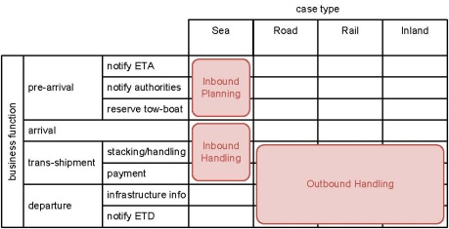
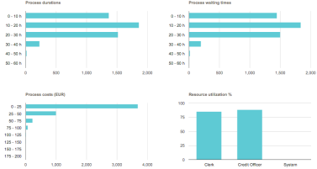

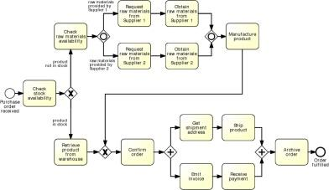
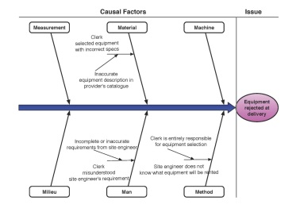
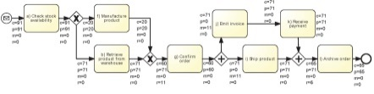
BPM Lifecycle

Slide 4
Process Discovery
Defining the setting: assemble a team in a company that will be responsible for working on the process.
Gathering information: build an understanding of the process. Different discovery methods can be used to acquire information on a process.
Conducting the modeling task: organize the creation of the process model. The modeling methodology gives guidance for mapping out the process in a systematic way.
Assuring process model quality: guarantee that the resulting process model meets different quality criteria. This phase is important for establishing trust in the process model.

Slide 5

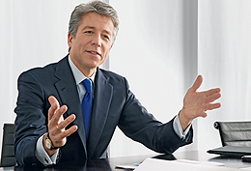
Who is involved?
Process Analyst
Domain Expert

Slide 6





Challenge 1: Fragmented Process Knowledge
I make a photocopy before handing over the application
Iterative validation process
Why can‘t I directly provide cash after approval?
We bundle refinancing to get better interest rates.

Slide 7

Challenge 2: Domain Experts think on Instance Level
“Every trip is different”
“You cannot really compare. Our customers go to different places in different seasons using different modes of transportation”
“We can never do anything exactly in the same way. There are so many special conditions”
Abstraction from instance level to process level

Slide 8
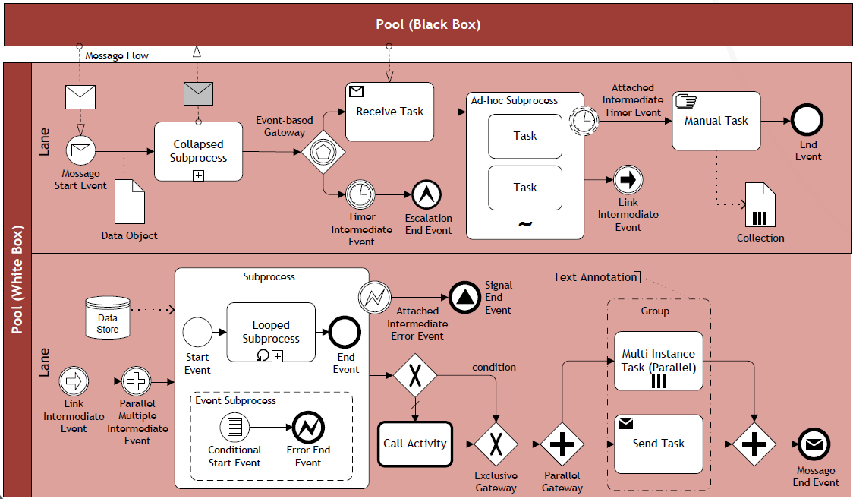
Challenge 3: Knowledge of Process Modelling is uncommon
“Could you please tell me, whether this diagram correctly shows your process?”
Translation to natural-language

Slide 9
What Makes a Good Process Analyst
Getting the right people on board
Formulate and test hypotheses
Identify patterns
Pay attention to model aesthetics

Slide 10


Process Discovery Methods
Evidence-based
Document analysis
Observation
Automatic process discovery
Interview-based
Workshop-based

Slide 11
Document Analysis
Documents point to existing roles, activities and business objects:
Process descriptions (ideal scenario)
Internal policies
Organization charts
Employment plans
Quality certificate reports
Glossaries and handbooks
Forms
Work instructions
May not be process-oriented and trustworthy.
Could be used to gather information before approaching domain experts.

Slide 12
Observation
Follow directly the processing of individual cases:
Active role: play a specific role, e.g. customer
Passive role: observe participants and their environment
Trace business objects in the course of their lifecycle
Active role: no big picture
Passive role: participants’ bias

Slide 13
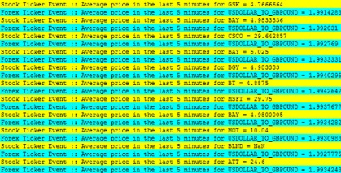

Automated discovery via Process Mining
event stream
Discovery
model
extract
Conformance
✓/✗
event log
DB
model

Slide 14
Interviews
Interview
Validation
Modelling
Verification
Forward vs. backward
Structured vs. unstructured
Assumption: analyst and stakeholder share terminology
Pitfall: exceptional behavior neglected > use questions that aim to identify such behavior

Slide 15
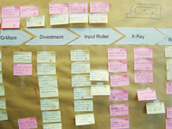
Workshops
Gather all key stakeholders together
Participants interact to create shared understanding
Typically one process analyst (facilitator), multiple domain experts, process owner may also attend
May be software-supported, a model is directly created during the workshop (typically a separate role – tool operator)
Model is used as reference point for discussions
Alternative: brown-paper workshops
Usually 3 to 5 half-day sessions

Slide 16
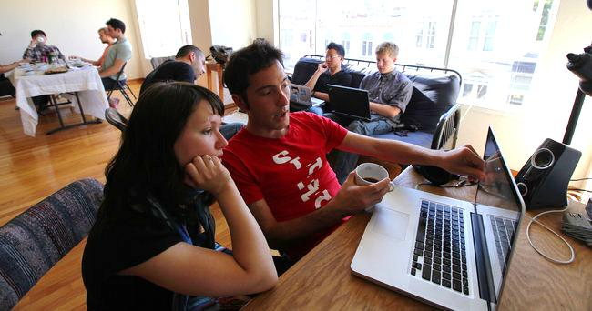
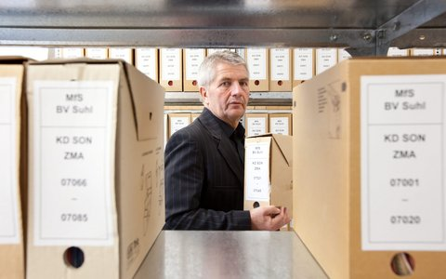
Any Difference in Discovery?
Consider the following two companies:
Company A is young, founded three years ago, and has grown rapidly to a current toll of one hundred employees.
Company B is owned by the state and operates in a domain with extensive health and security regulations.
How might these different characteristics influence a workshop-based discovery approach?

Slide 17
Discovery and Culture
Before starting with process discovery, it is important to understand the culture and the sentiment of an organization.
There are companies that preach and practice an open culture in which all employees are encouraged to utter their ideas and their criticism. Such organizations can benefit a lot from workshops as participants are likely to present their ideas freely.
In strictly hierarchical organizations, it is necessary to take special care that every participant gets an equal share of parole in a workshop and that ideas and critique are not held back.
It might be the case that the young dynamic company has a more open culture than the company with extensive health and security regulations. This has to be taken into account when organizing a workshop.

Slide 18
Strengths and Weaknesses
Technique | Strength | Weakness
Document Analysis | Structured information Independent from availability of stakeholders | Outdated material Wrong level of abstraction
Observation | Context-rich insight into process | Potentially intrusive Stakeholders likely to behave differently Only few cases
Automatic Discovery | Extensive set of cases Objective data | Potential issue with data quality
Interview | Detailed inquiry into process | Requires sparse time of process stakeholders Several iterations required before sign-off
Workshop | Direct resolution of conflicting views | Requires availability of several stakeholders at the same time

Slide 19
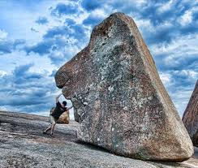
Effort of Process Discovery
Consider the order-to-cash process of your favorite online book retailer has ten major activities that are conducted by different persons.
How much time do you approximately need for creating a process model that is validated and approved by the process owner? Make appropriate assumptions.

Slide 20
Process Discovery Effort
This process contains ten major activities that are executed by different persons. We can assume that there will be a kickoff meeting with the process owner and some important domain experts on day one. 1 day might be required to study the available documentation. An interview with one domain expert can take 2-3 hours, so we would be able to meet two persons per day, and document the interview results at nighttime (yes, at nighttime). Let us assume that we meet some persons only once while we seek feedback from important domain experts in 2 additional interviews. Then, there would be a final approval from the process owner. This adds up to 1 day for the kickoff, 1 for studying the documentation, 5 days for the first iteration interviews, and further 5 days if we assume that we meet 5 experts 3 times. Then, we need 1 day for preparing the meeting for final approval with the process owner, which would be on the following day. If there are no delays and scheduling problems, this yields 2 + 5 + 5 + 2 = 14 days of work as a minimum.

Slide 21
Organizing the Gathered Material
Identify the process boundaries
Identify activities and events
Identify resources and their handovers
Identify the control flow
Identify additional elements

Slide 22
Process Boundaries
Under which condition does the process start?
With which result does it end?
Which perspective do we assume?
What data are required as input and output to the process?

Slide 23
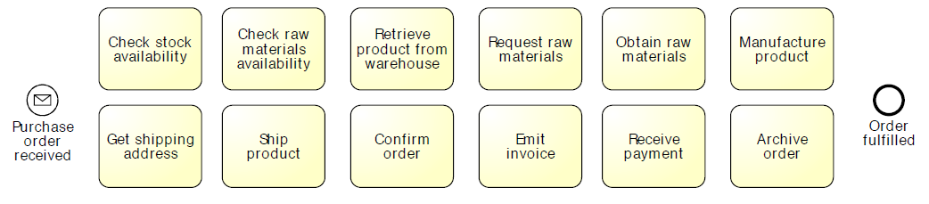
Identify Activities and Events

Slide 24
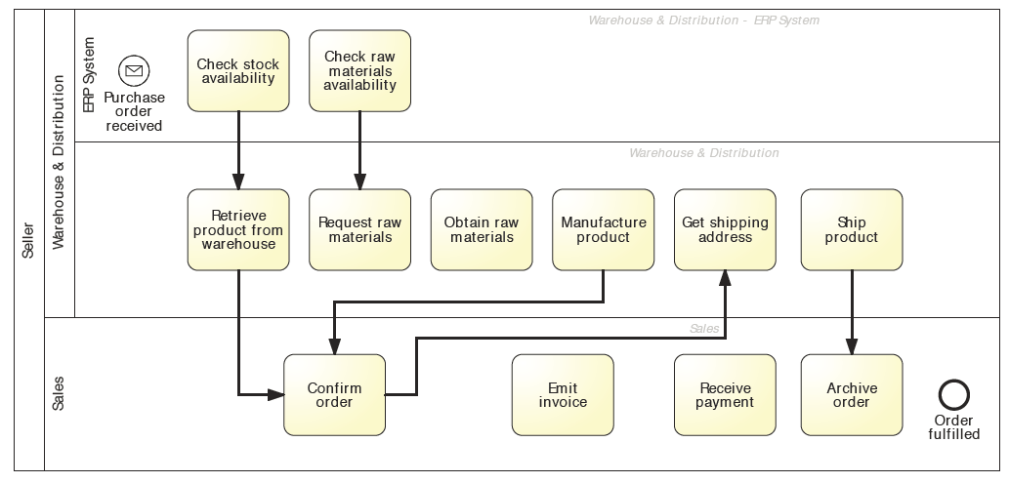
Identify Resources and Handovers

Slide 25
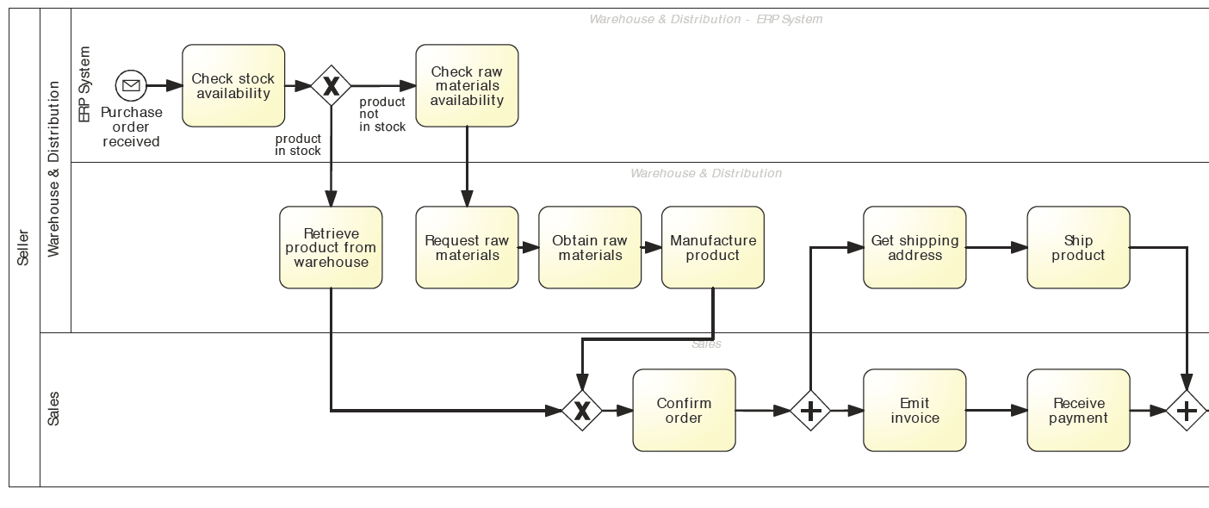
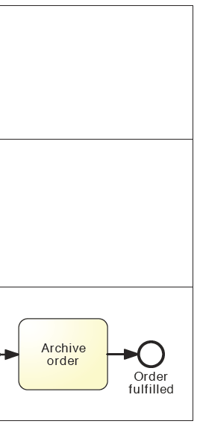
Identify Control Flow

Slide 26
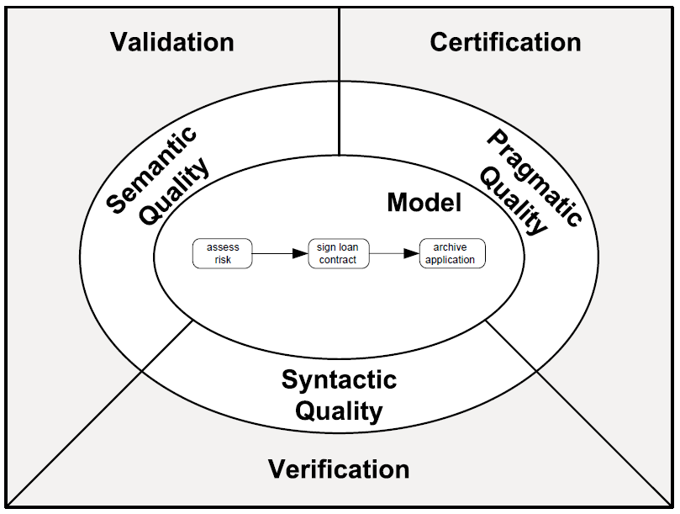
Process Modelling Quality Assurance
Validity
Completeness
Understandibility
Mantainability
Structural correctness
Behavioral correctness

Slide 27
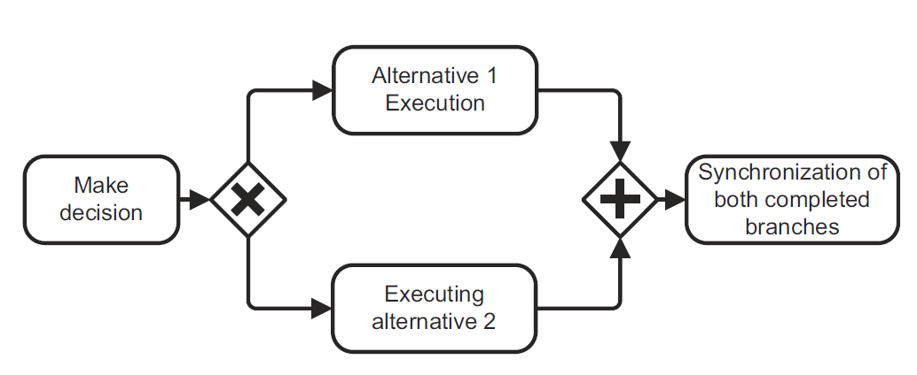
Is this process model of good quality?
Deadlock

Slide 28
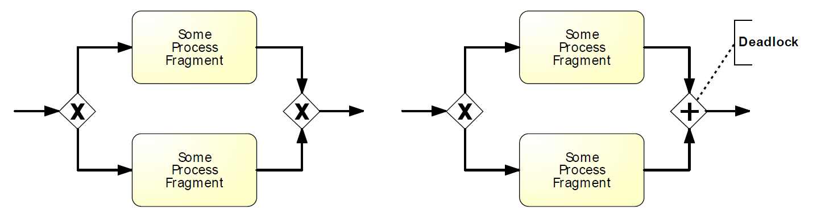
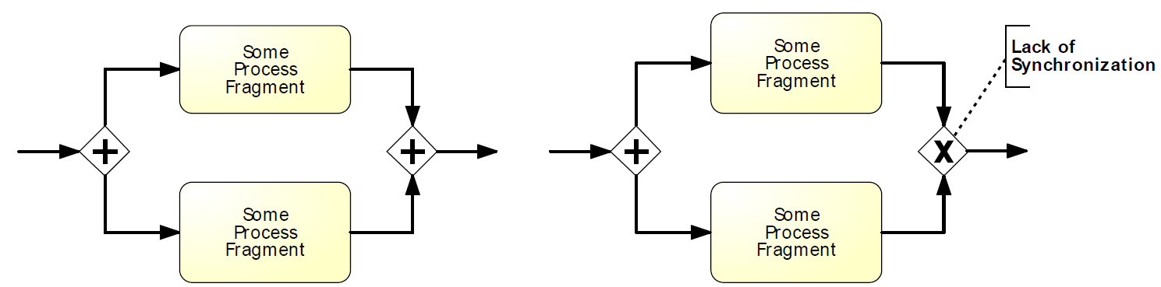
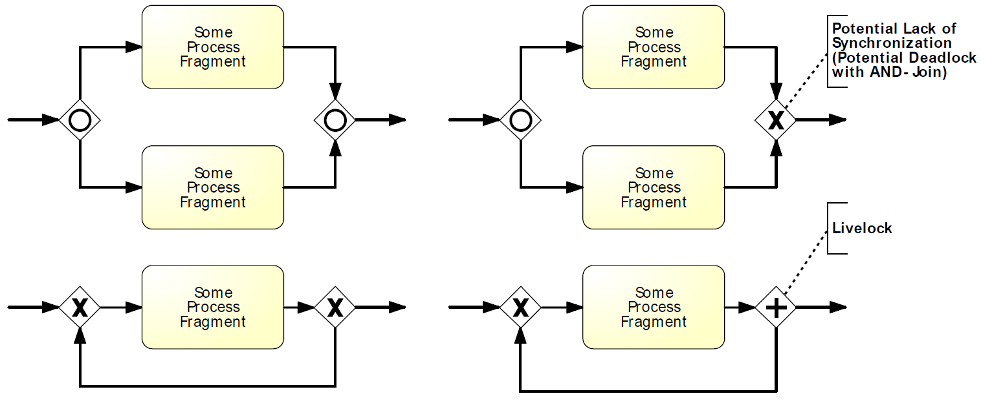
Syntactic Quality: Verification

Slide 29
Is this process model of good quality?
Deadlock
Labeling

Slide 30
Formulate Labels Adequately
Activities as Verb-Object
Events as Object-Past-Participle Verb
Conditions with reference to Object

Slide 31
Semantic Quality: Validation
Validity
Completeness
Domain Expert
Process Analyst

Slide 32
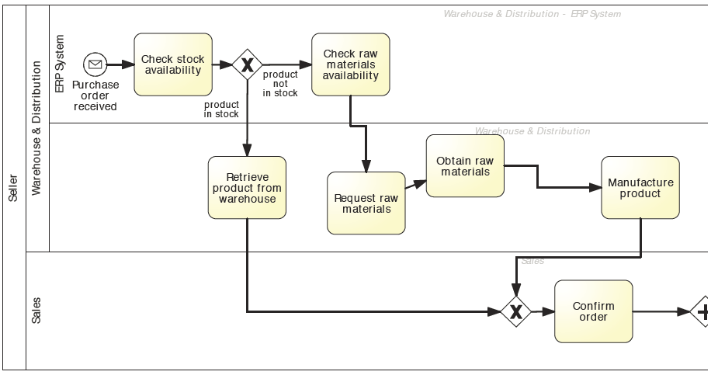
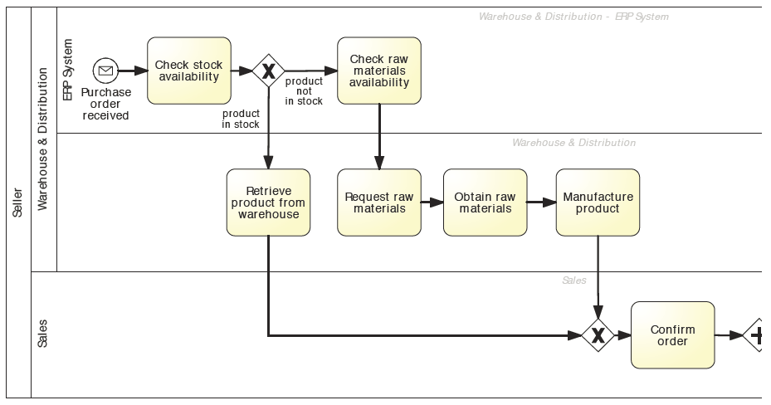
Pragmatic Quality – Example: Layout
Better layout helps understanding

Slide 33
Seven Process Modeling Guidelines (7PMG)
G1 Use as few elements in the model as possible
G2 Minimize the routing paths per element
G3 Use one start and one end event
G4 Model as structured as possible
G5 Avoid, where possible, OR routing elements
G6 Use verb-object activity labels
G7 Decompose a model with more than 30 elements

Slide 34
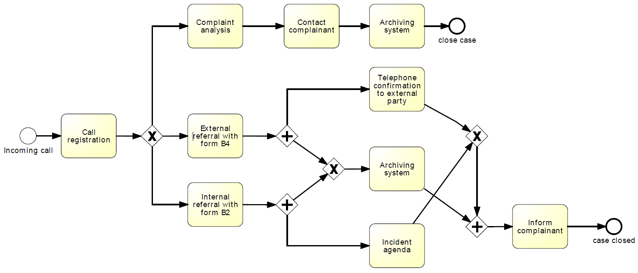
Example: explain which 7PMG guidelines point to potential for improvement. Remodel the process based on your observations.

Slide 35
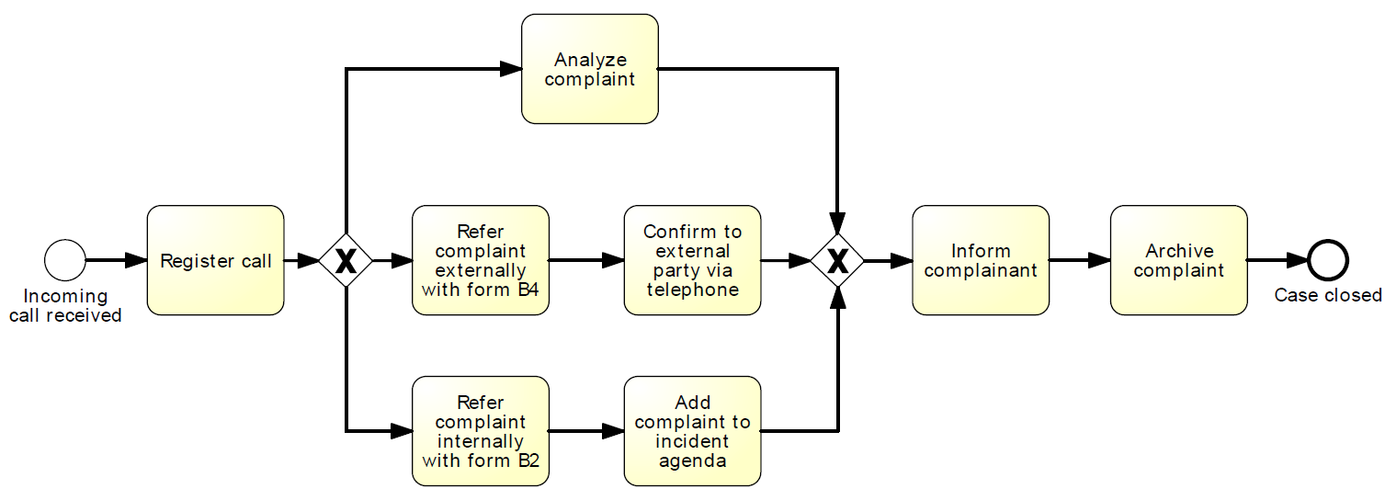
Solution

Slide 36
Process Discovery - Summary
Domain expert and process analyst have different strengths and limitations in process discovery
There are various discovery methods
Quality Assurance is important

Slide 37

References
Required
Chapter 5 of textbook “Fundamentals of BPM”
Recommended
M. Rosemann, “Potential pitfalls of process modeling: Part A”. Bus. Process. Manag. J. 12(2), 249–254 (2006)
M. Rosemann, “Potential pitfalls of process modeling: Part B”. Bus. Process. Manag. J. 12(3), 377–384 (2006)
J. Mendling, H.A. Reijers, W.M.P. van der Aalst, “Seven process modeling guidelines (7PMG)”. Inf. Softw. Technol. 52(2), 127–136 (2010)
J. Mendling, L. Sánchez-González, F. García, M. La Rosa, “Thresholds for error probability measures of business process models”. J. Syst. Softw. 85(5), 1188–1197 (2012)
J. Mendling, H.A. Reijers, J. Recker, “Activity labeling in process modeling: empirical in- sights and recommendations.” Inf. Syst. 35(4), 467–482 (2010)
Books
A. Sharp, P. McDermott, “Workflow Modeling: Tools for Process Improvement and Application Development”, 2nd edn., Artech House (2008)

Slide 38


A/Prof. Marcello La Rosa IS School Academic Director (Corporate Programs and Partnerships) BPM Discipline, IS School
Science & Engineering Faculty Queensland University of Technology 126 Margaret Street Brisbane QLD 4000 Australia
p +61 (0)7 3138-9482 e m.larosa@qut.edu.au w www.marcellolarosa.com

